Slide 1

AMS ENGINEERING SOLUTION
C/O Landage Sagar Hiraman, S R No 95, Ground Floor, Near Intelligent
Cadet School, Pune - Nashik Highway, Bhosari., PUNE, PUNE,
MAHARASHTRA, 411039
Mould Manufacturer & Exporters
Email id:- E-mail – ams.moldsolutions @gmail.com Mobile:- 9819806921
Contact person- Mr. Sanjib Mohanty
MANUFACTURING OF All TYPES OF HOUSE APPLIANCES PLASTIC MOLDS / AUTOMOTIVE MOLDS, RUBBER MOLDS

Slide 2
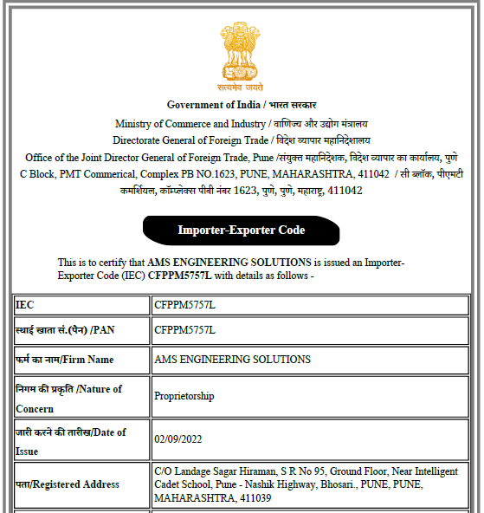
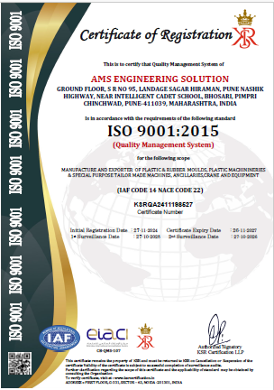
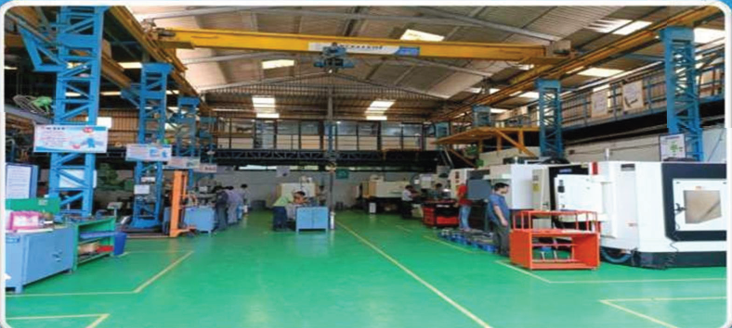
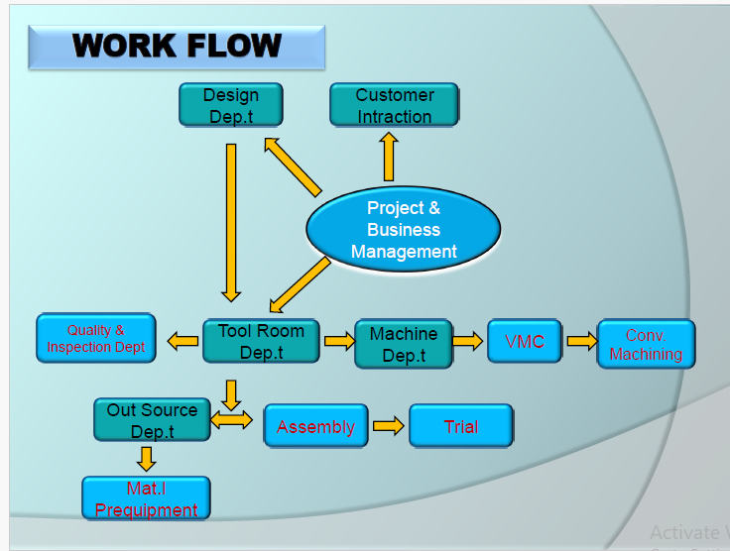
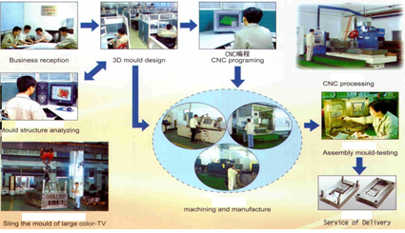
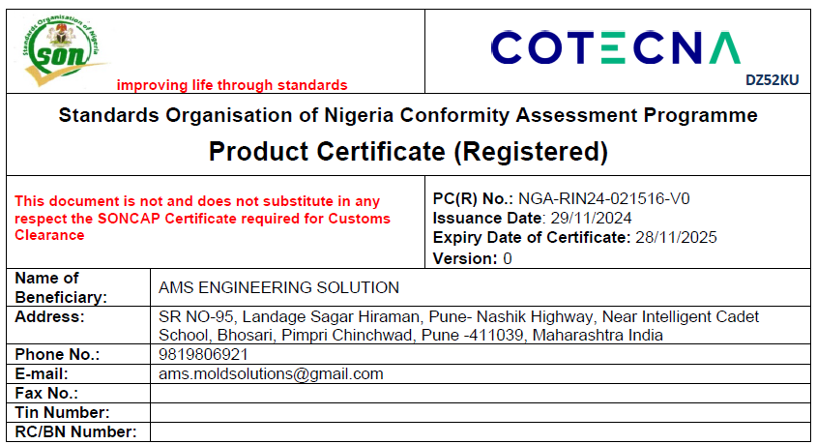

Slide 3
Vision
To become preferred service provider in tooling solutions.
Mission
To build customer confidence & competitiveness in precision manufacturing mold & dies
Values
Integrity, Reliable, trust , sincerity

Slide 4
MOULD EXPORT TO VARIOUS COUNTRY
Mould Manufacturer & Exports
HOUSE APPLIANCES MOULD
THIN WALL COMPONENTS
AUTOMOTIVE SECTORS
RUBBER INDUSTRIES
Expertise in

Slide 5

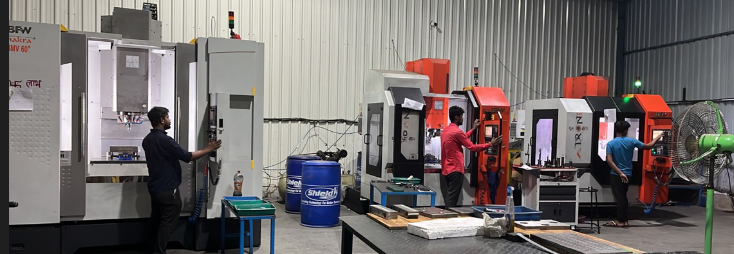
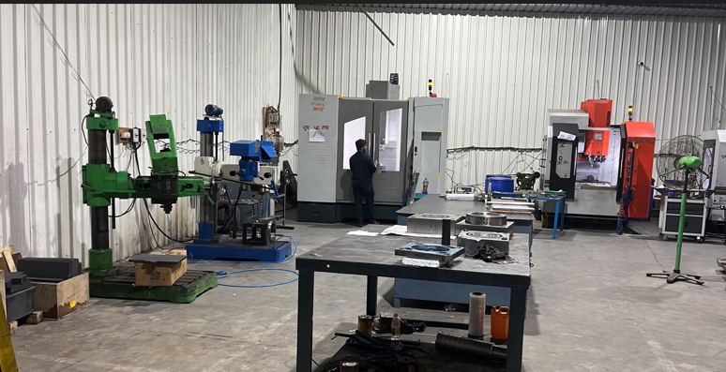
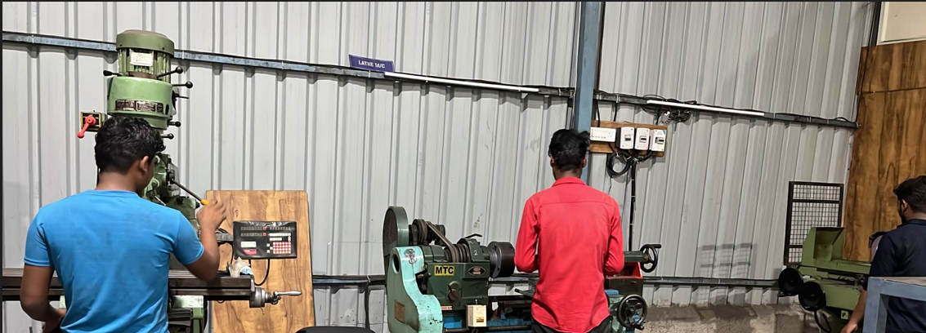
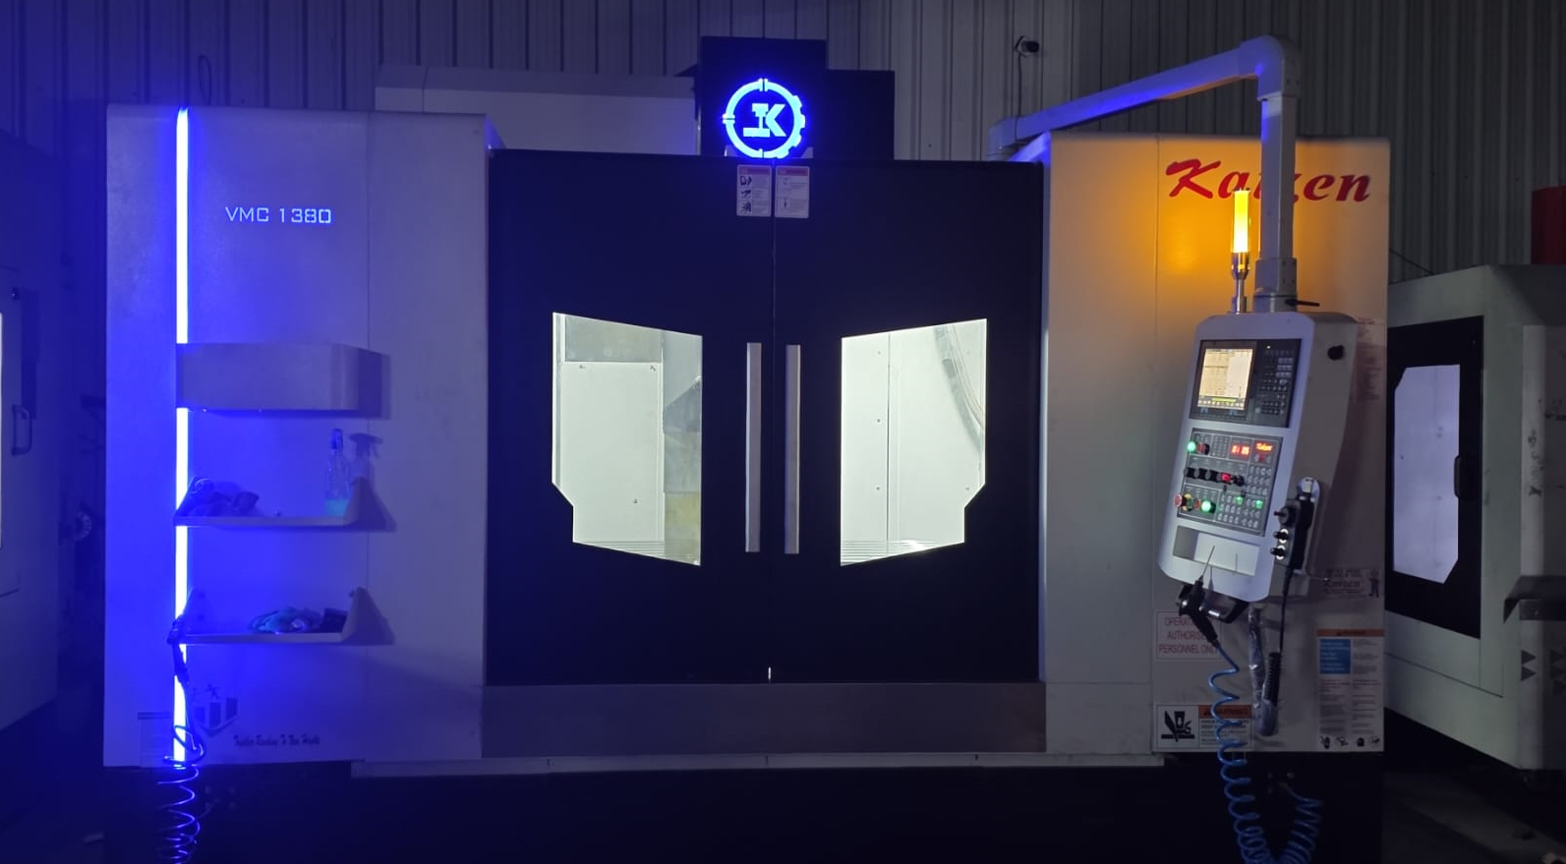
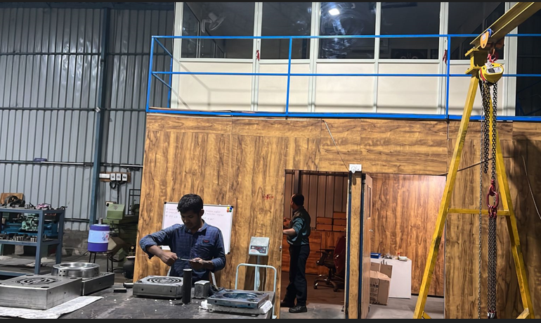

Slide 6
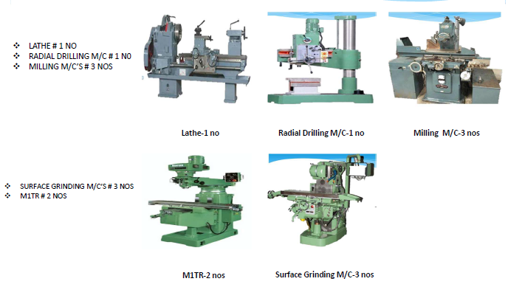
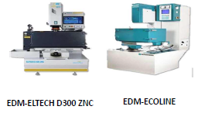

Slide 7
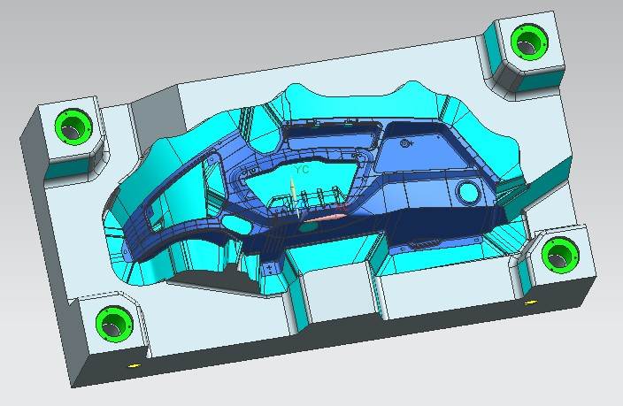
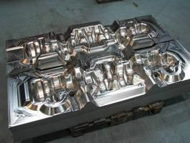
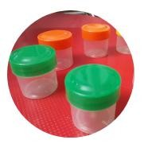
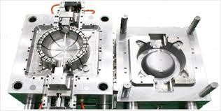
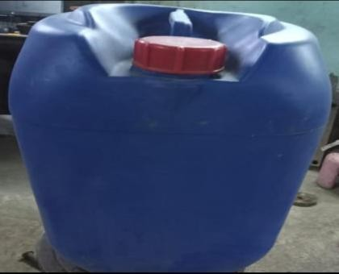
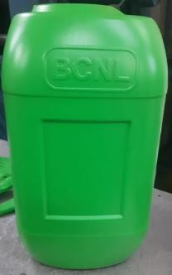
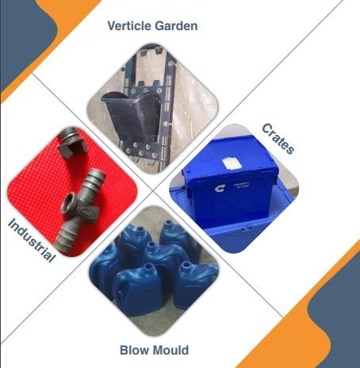

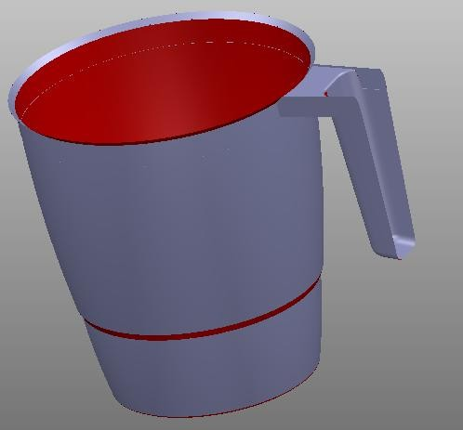
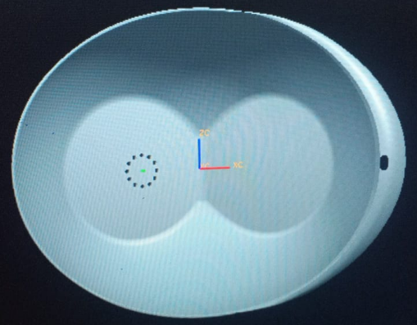
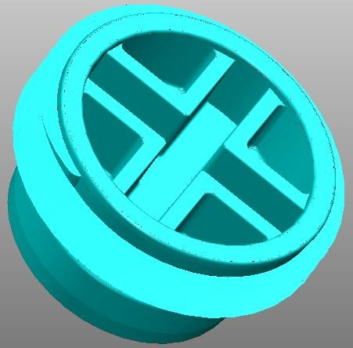
Export customers
Designo Mold
Mimi Ventures
SPL(BCNL)
AMBER PRIME PLASTICS

Slide 8
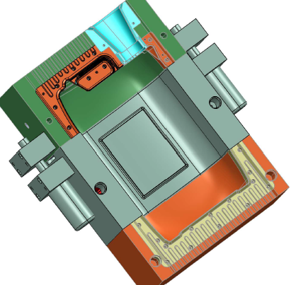
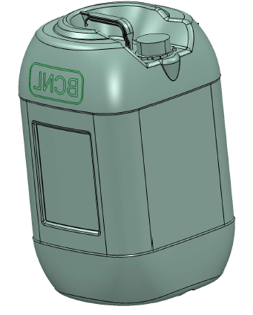
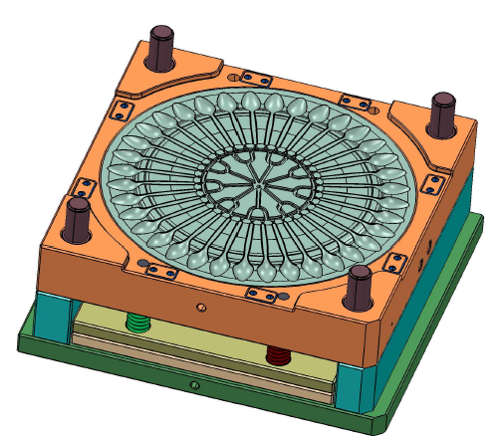
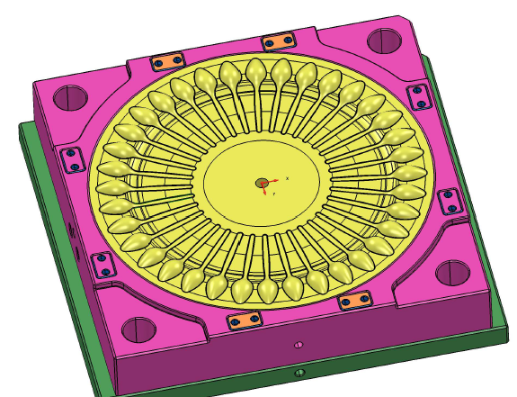
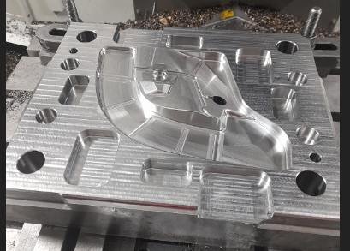
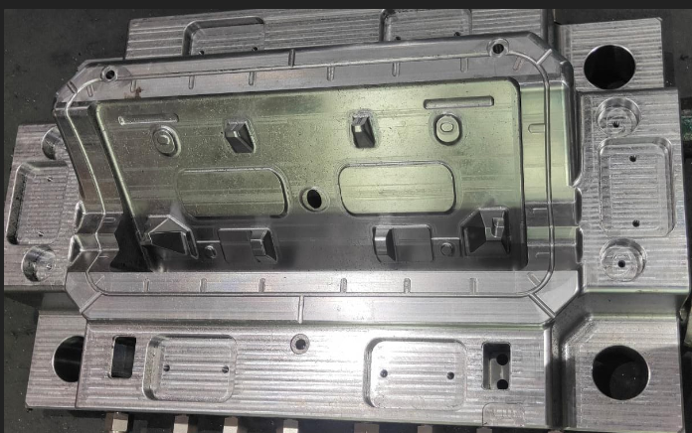
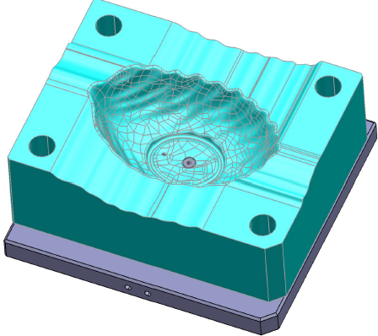
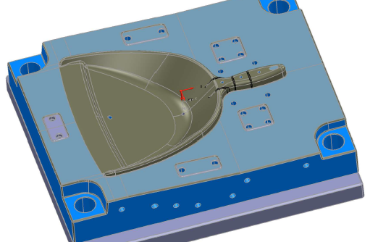
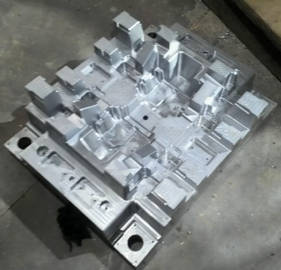
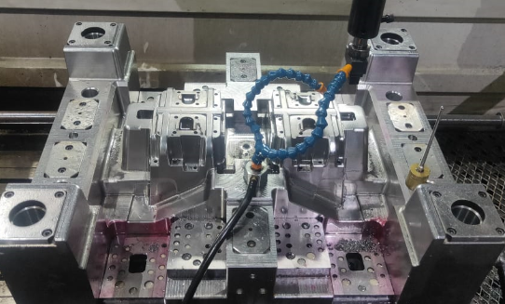

Slide 9
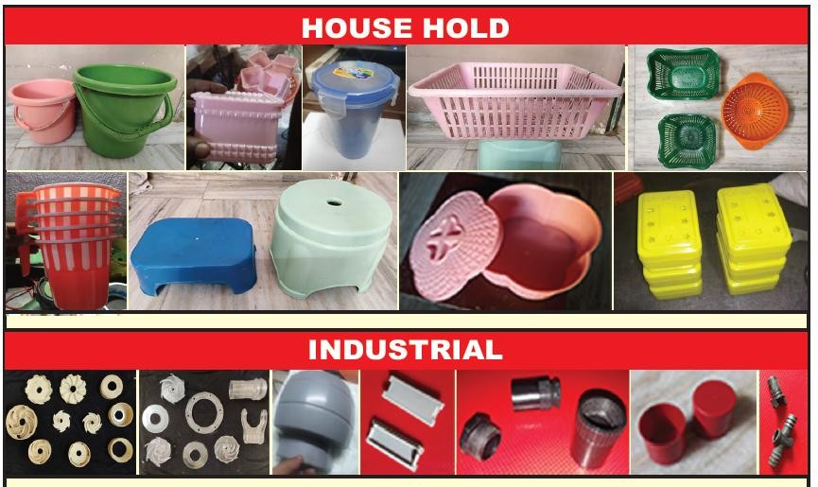
Mould Manufacturer & Exports

Slide 10
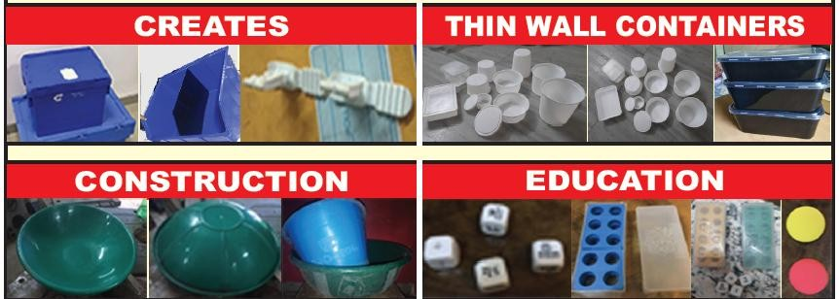
Mould Manufacturer & Exports

Slide 11
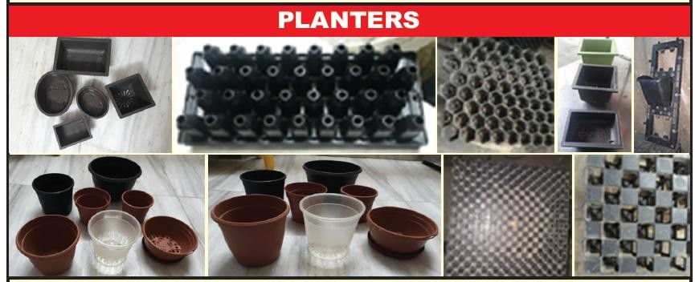
Mould Manufacturer & Exports

Slide 12
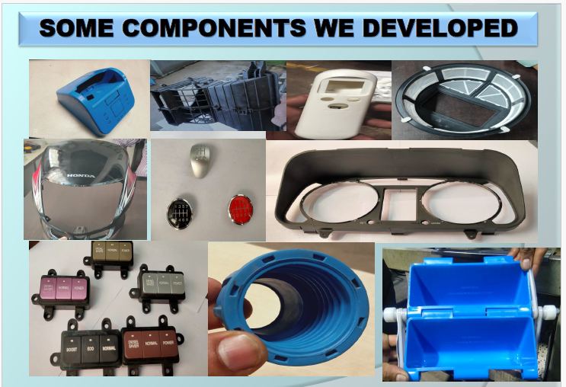
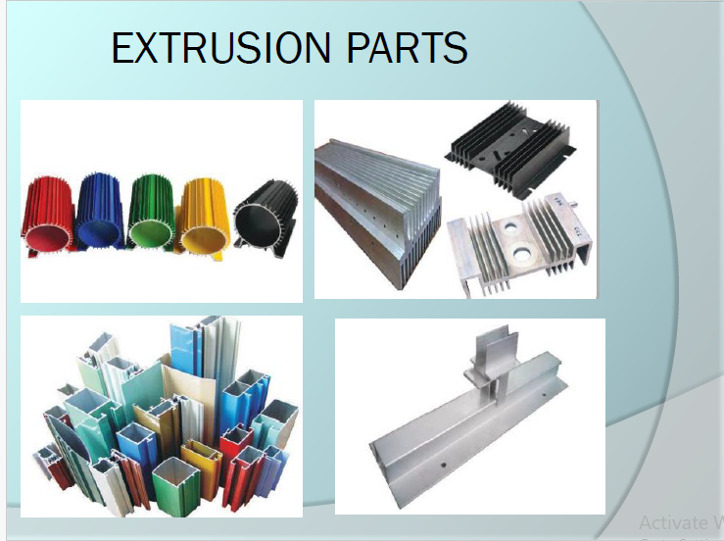

Slide 13


AMS ENGINEERING SOLUTION
C/O Landage Sagar Hiraman, S R No 95, Ground Floor, Near Intelligent
Cadet School, Pune - Nashik Highway, Bhosari., PUNE, PUNE,
MAHARASHTRA, 411039
Email id:- E-mail – ams.moldsolutions @gmail.com Mobile:- 9819806921
Contact person- Mr. Sanjib Mohanty

